Slide 1
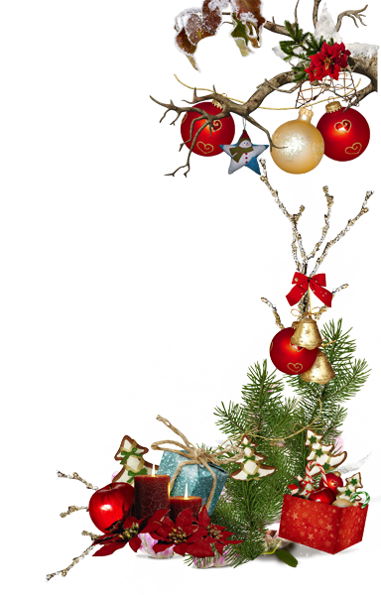
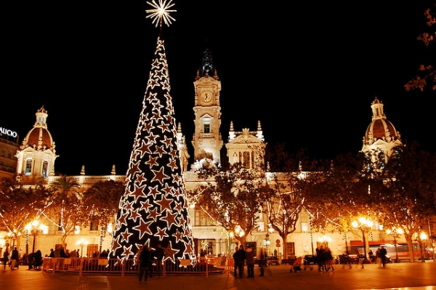
Christmas in Spain
Facts and traditions

Slide 2
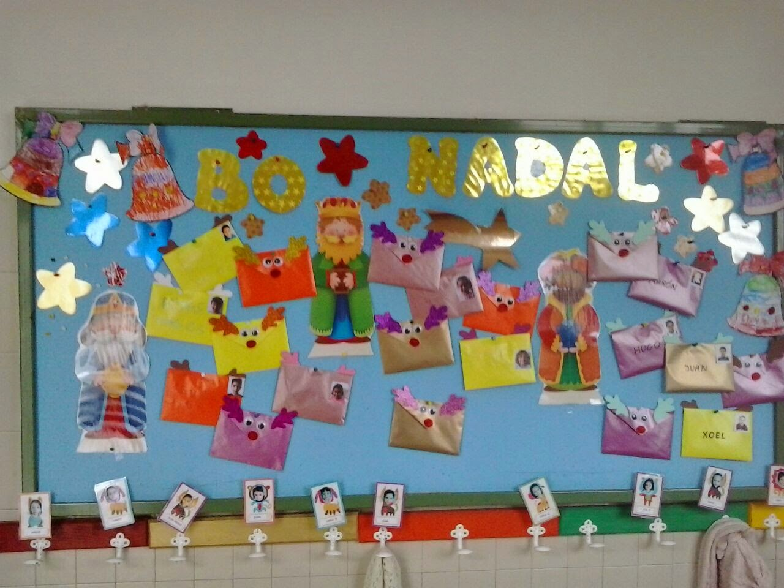
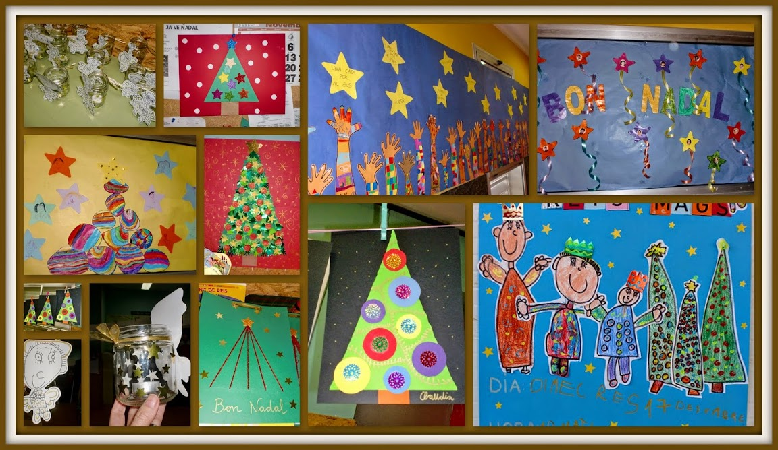
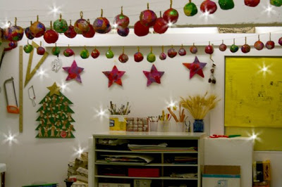
Before Christmas arrive...
The children prepare decorations with different materials, such as bells, coloured balls, stars, ribbons, etc. which are hung up in the classrooms.

Slide 3
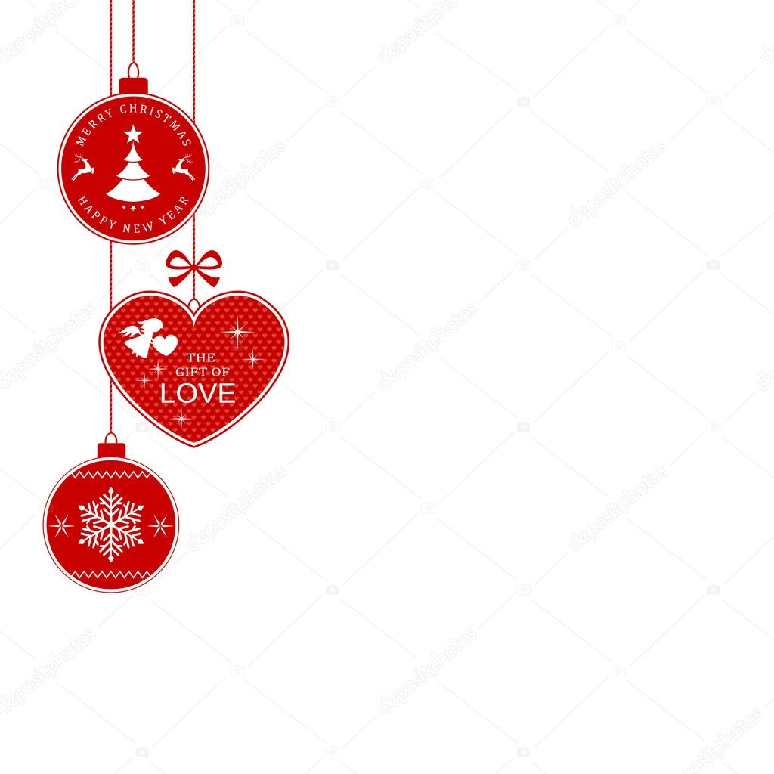
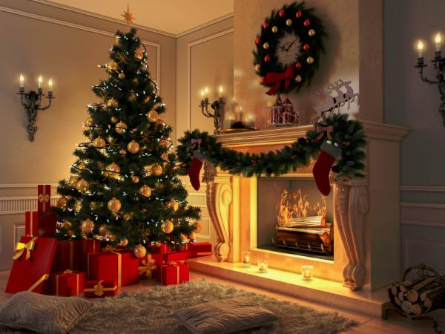
We also decorate our houses

Slide 4
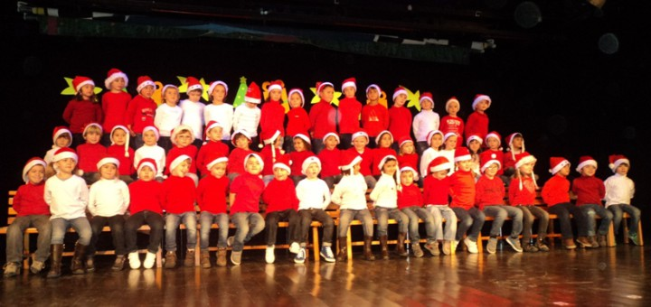
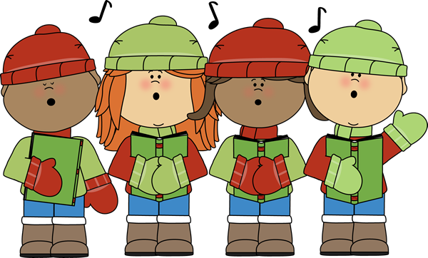
We have a festival at school
The whole school sing Christmas carols for the families.

Slide 5
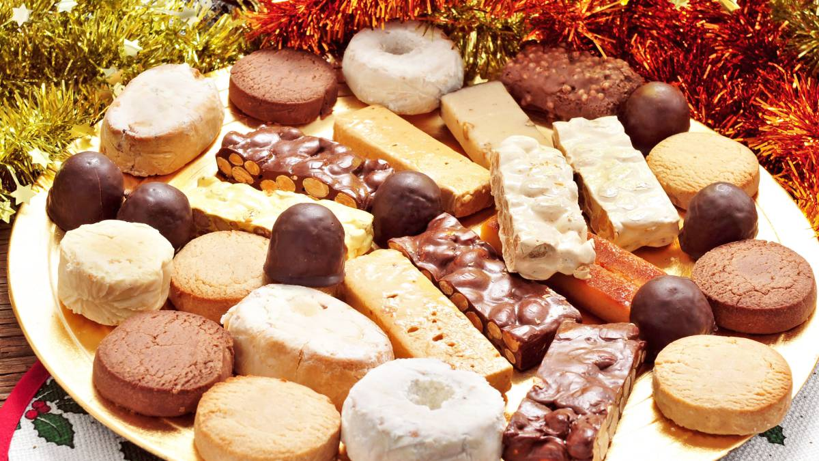
24th of december
Christmas Eve is celebrated on December 24th. The whole family gathers around the special dinner, which is accompanied by cider, cava and traditional Christmas sweets, such as nougat candy, marzipan and “polvorones”.

Slide 6
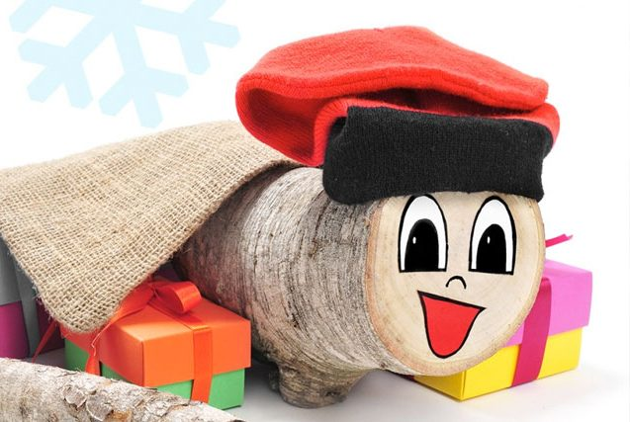
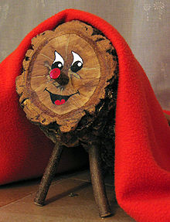
“CAGA TIÓ””
Also in Barcelona, the part of Spain where we live we have an special tradition that is instead of having Father Christmas, we have a piece of wood called caga tió who brings us presents that night.

Slide 7
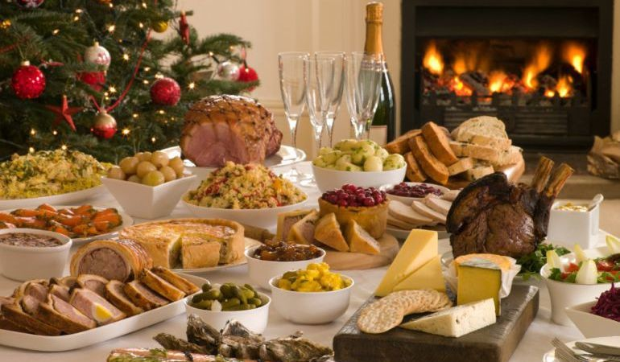
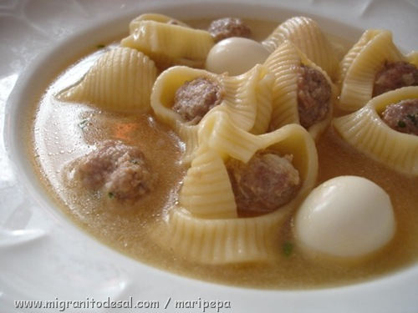
CHRISTMA’S DAY
We have a speciall lunch with our family.

Slide 8
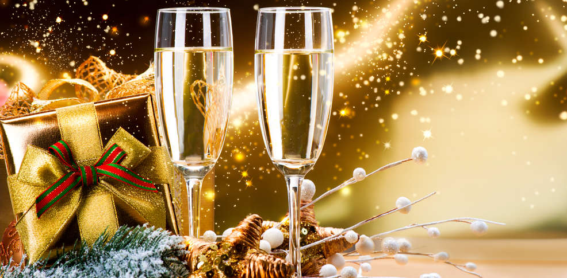
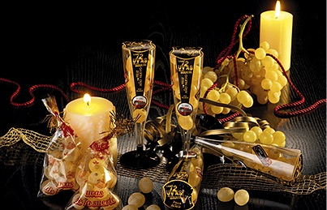
NEW YEAR’S EVE
We have dinner with our family. We dress up with our best costumes.
At twelve o’clock we eat 12 grapes. Children sometimes we eat some chocolate instead.

Slide 9
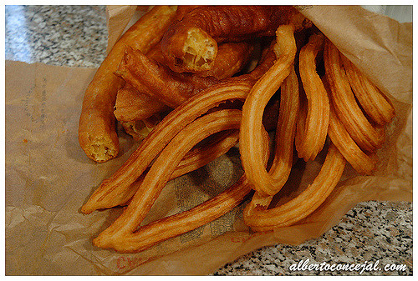
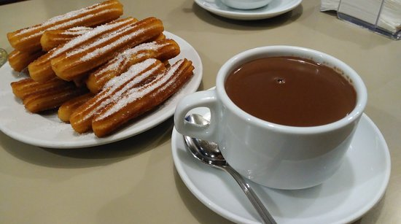
Special breakfast
The morning after Christmas Eve we eat chocolate with “churros”.

Slide 10
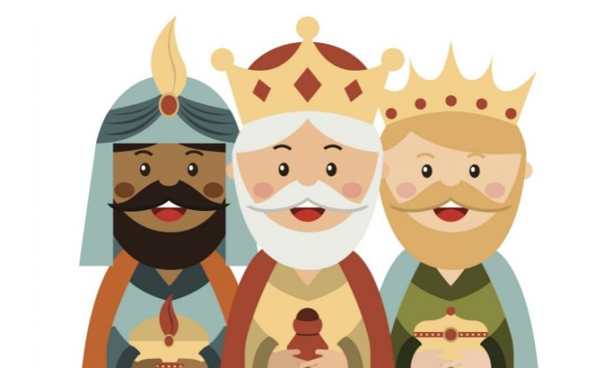
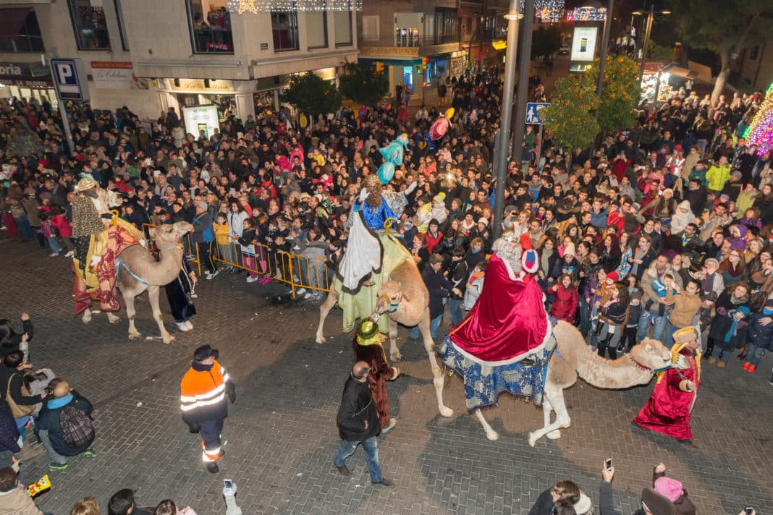
5th of January
The three kings come the day before Epiphany.
They bring presents and there are parades in the cities.

Slide 11
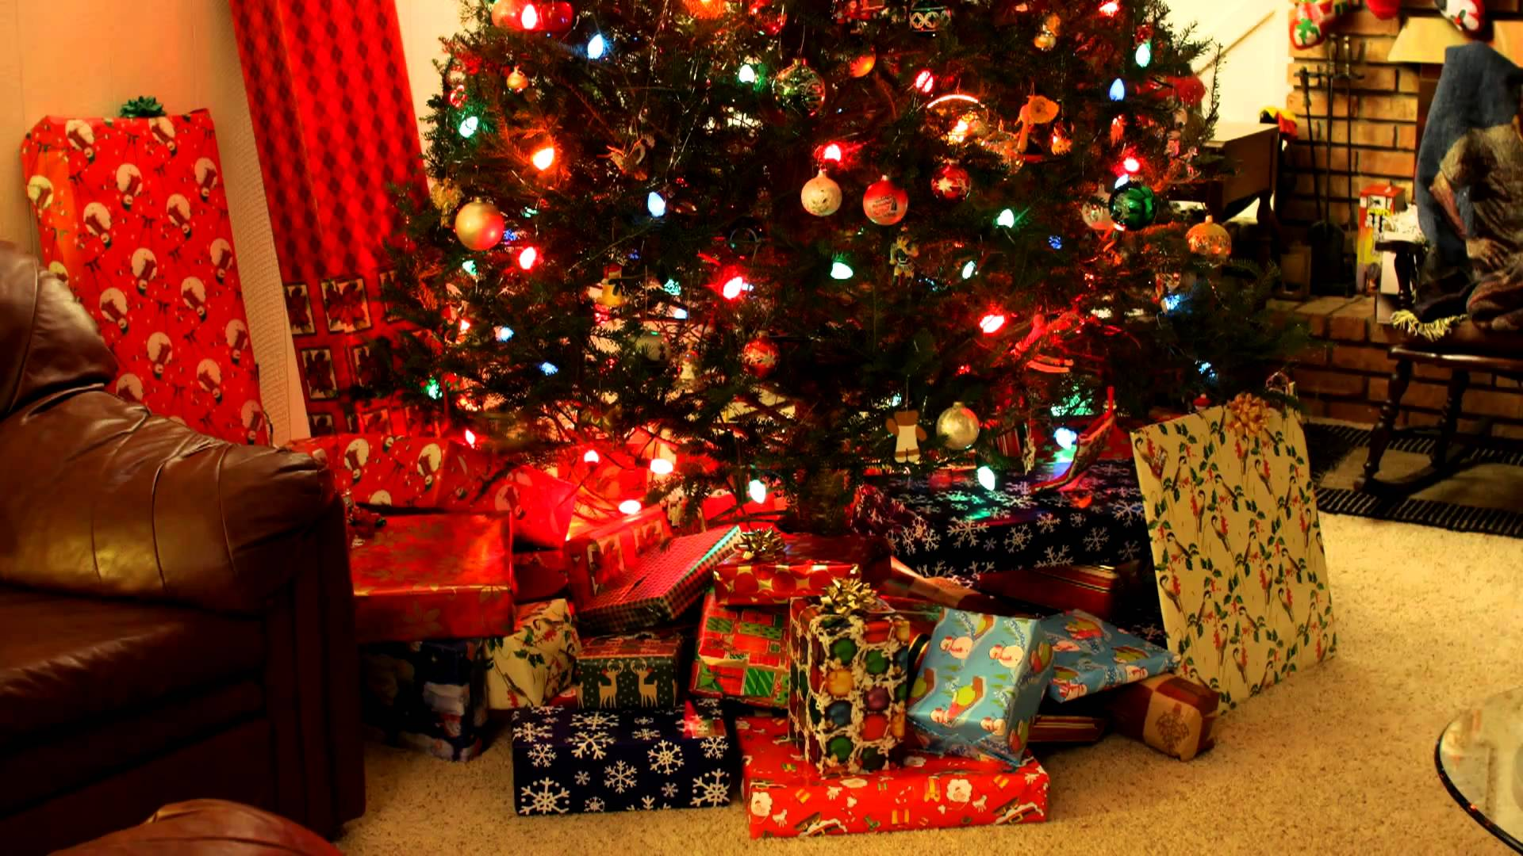
6th of January
When we get up, we have lots of presents under our Christmas tree.

Slide 12
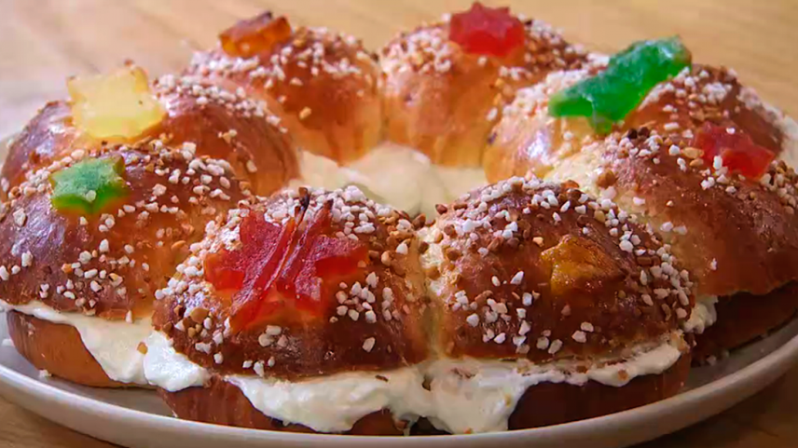
“Roscón de reyes”
It’s also a tradition to eat a sweet cake called “roscón de reyes” after lunch the 6th of January. The most famous one is filled with cream or marzipan. Inside you can find a little king of a bean. If you find the king you will put the crown that is in the “roscón” but if you find the bean you will pay the cake.

Slide 13
MERRY CHRISTMAS BON NADAL! ¡FELIZ NAVIDAD!

